Slide 1

Nmap and Docker
Before we get started, install Nmap and Docker

Slide 2
Scanning tool: NMAP
Like many tools in cybersecurity, NMAP is an open source tool to explore a network by scanning ports, services, and hosts by sending and receiving packets. The responses to those packets are then used to gather information on the target.
It’s seen as one of the best tools in first step network analysis

Slide 3
Nmap in CTFS
Nmap isn’t used as an end-all tool to solve CTFs, rather, like OSINT, it is best used when starting out, to gather information and make decisions as to what to approach next.
Biggest things to look for: Which common ports are open? Such as 80, 22, 443.. Etc, and which uncommon ports are open, i.e. 1000+
Example:
https://deskel.github.io/posts/thm/simple-ctf
https://www.hackingarticles.in/hack-the-wintermute-1-ctf-challenge/
https://www.secjuice.com/tryhackme-simple-ctf/

Slide 4
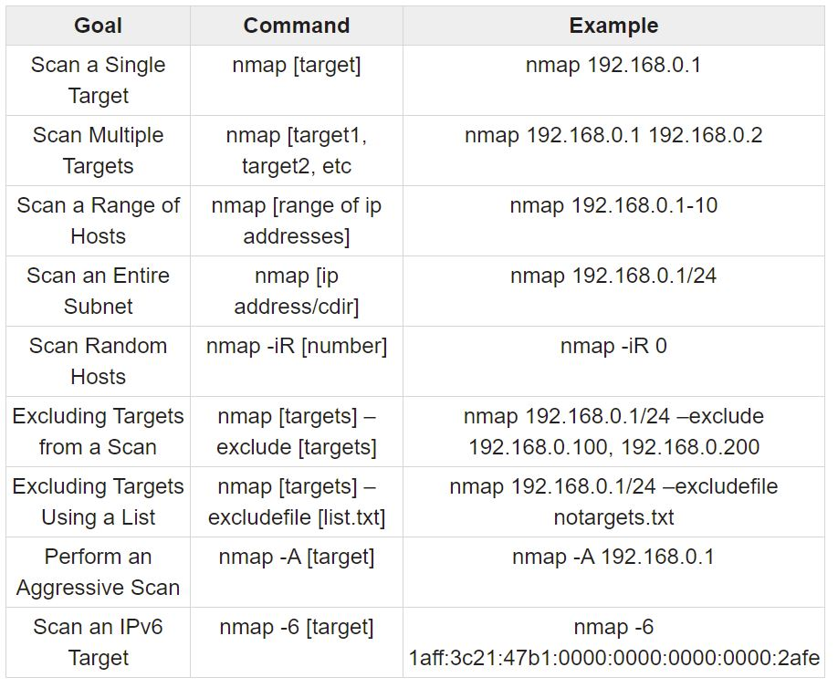
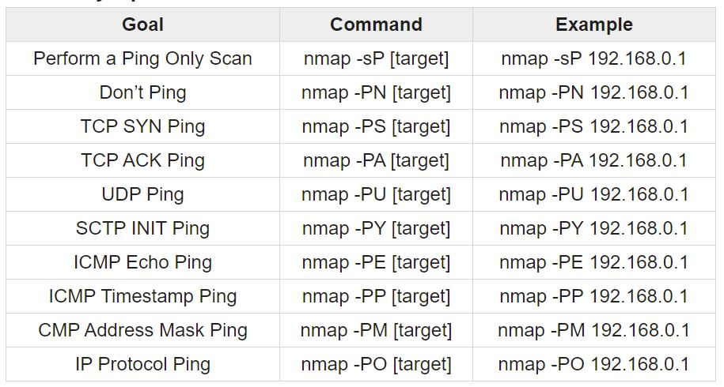
Basic NMAP Commands: 18.117.171.144 & 3.15.39.9

Slide 5
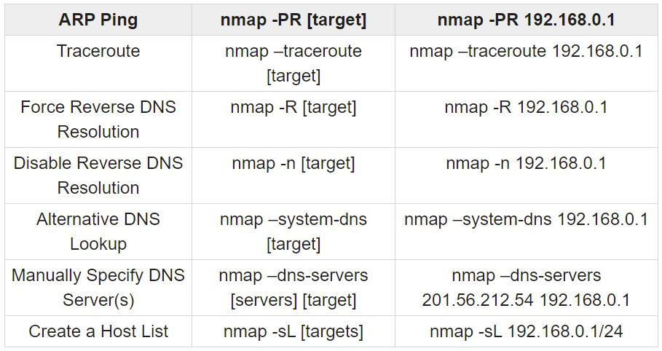
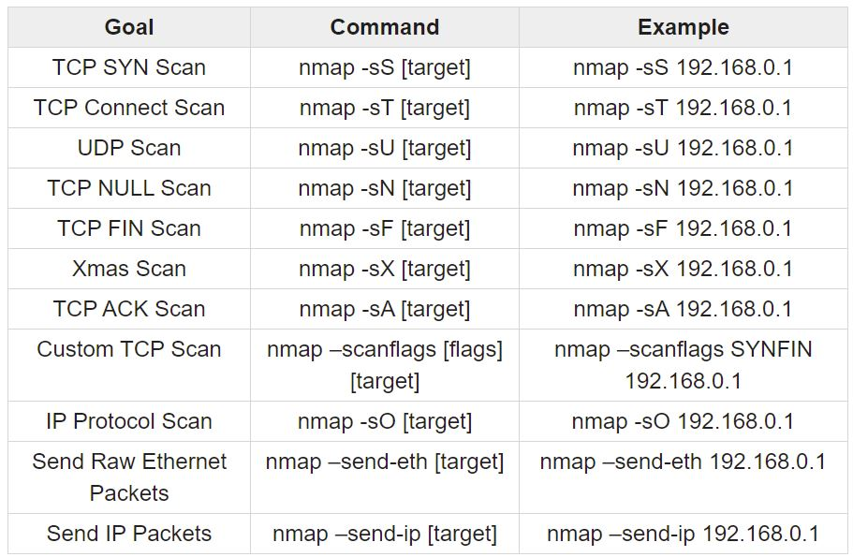
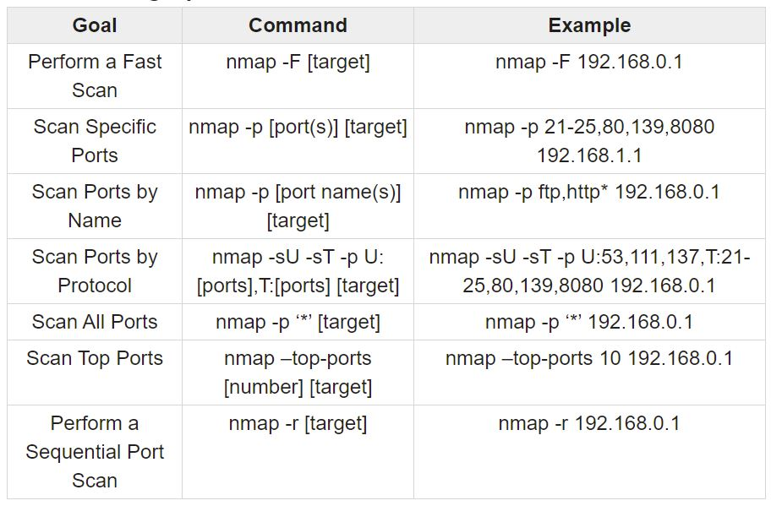

Slide 6
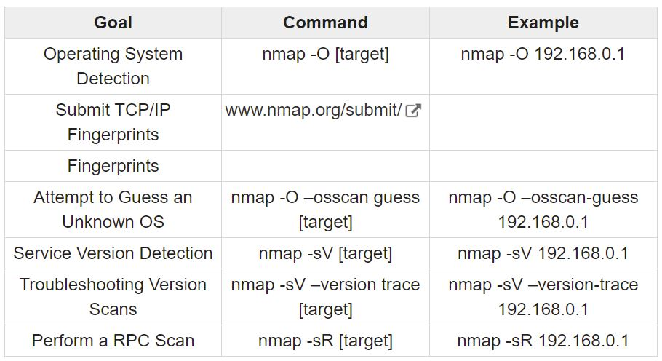
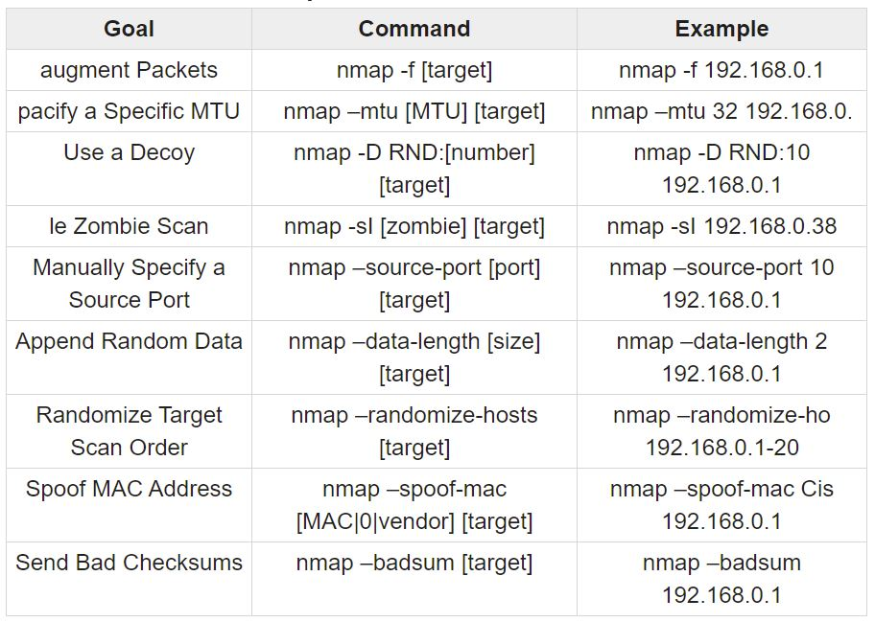
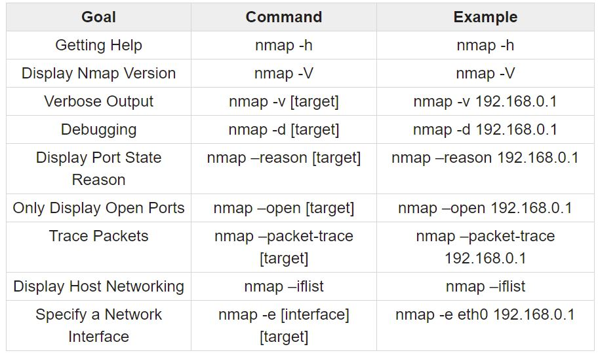

Slide 7
Additional resources and links
https://www.tutorialspoint.com/nmap-cheat-sheet
https://nmap.org/book/
https://youtu.be/4t4kBkMsDbQ
https://aws.amazon.com/security/penetration-testing/

